Slide 1
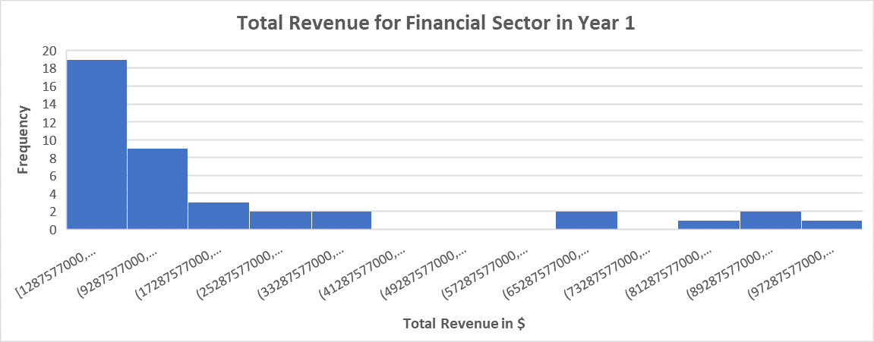
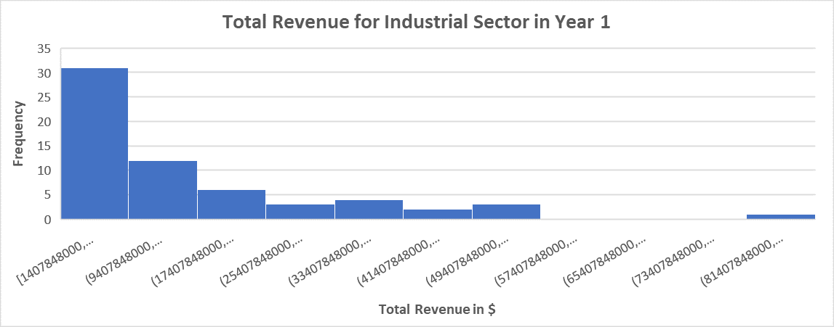
How does the total revenue compare between the Industrial Sector and the Financial Sector in Year 1?
Data visualization of histograms for total revenue from the Industrial and Financial Sectors in Year 1
Both histograms are right-skewed, meaning the means are greater than the medians.
The mean for the Financial Sector is $21 billion while the Industrial Sector sits at $16 billion. The median for both sits around $10 billion. Standard Dev is higher for the Financial Sector as well ($28 billion for Financial and $17 billion for Industrial). This means while the Financial Sector brought in a higher total revenue, the variability was also greater than the Industrial Sector. It will be more favorable to invest in an industry with a lower standard deviation due to less risk More than 50% of the companies from both sectors also brought in revenue of over $10 billion.

